Slide 1
COURSE REGISTRATION &
TIMETABLE BUILDER
Team No: 18
Team Members:
M. Gnanavardhan Reddy — 2620090133
B. Ganesh — 2620040132
Under Guidance: V Gopikrishna

Slide 2
Abstract
Project Overview
Course Registration & Timetable Builder is a Java-based project for managing course selection and timetable planning.
Students can view course details, register for selected courses, and organize their weekly schedule.
The system aims to reduce manual work, avoid timetable clashes, and make academic planning easier.
Java concepts are applied to validate inputs, process course data, and generate a clear schedule.

Slide 3
Understanding the Problem Statement
Problem Statement
Manual course registration takes time and can lead to data-entry mistakes.
Students may find it difficult to compare course timings and available sections.
Overlapping class times can create timetable conflicts.
A simple centralized system is needed to manage course details and prepare an organized timetable.

Slide 4
CO1: Java Basics & Computational Thinking
CO1 — Java Basics and Computational Thinking
Topics: variables, data types, operators, input, and output.
Use these basics to collect student details and course information.
Apply computational thinking to break registration tasks into clear steps.
Learning outcome: understand the basic building blocks of a Java application.

Slide 5
CO2: Conditional Statements & Loops
CO2 — Conditional Statements and Loops
Topics: if-else, switch, for loops, and while loops.
Use conditions to validate course choices and check registration rules.
Use loops to display available courses and process multiple registrations.
Learning outcome: solve project problems using decisions and repetition.

Slide 6
CO3: Arrays, Strings & Methods
CO3 — Arrays, Strings, and Methods
Topics: arrays, strings, and reusable methods.
Store course codes, names, days, and timings in suitable data structures.
Use methods to display course details and prepare timetable information.
Learning outcome: store data clearly and reduce repeated code.

Slide 7
CO4: Classes and Objects
CO4 — Classes and Objects
Topics: classes, objects, fields, constructors, and methods.
Create a Course class to represent course code, course name, day, and time.
Create objects for individual courses and use methods to display details.
Learning outcome: understand and apply basic object-oriented programming.

Slide 8
CO5: Problem-Solving and Debugging
CO5 — Problem-Solving and Debugging
Test course registration with different inputs and combinations.
Check for missing details, invalid choices, and overlapping class times.
Read compiler errors, trace program logic, and correct mistakes.
Learning outcome: write, test, debug, and improve a working program.

Slide 9
CO6: Programming Project and Application
CO6 — Programming Project and Application
Combine Java basics, conditions, loops, methods, arrays, and classes in one project.
Allow users to view courses, register for courses, and see timetable details.
Demonstrate a practical application of programming concepts to a student need.
Learning outcome: apply learned concepts to build a complete program/project.

Slide 10
Conclusion
Conclusion and Future Scope
The project organizes course selection and timetable planning in one system.
It can reduce manual effort and help students identify scheduling conflicts.
The project demonstrates Java programming, object-oriented design, and debugging.
Future scope: database storage, login accounts, course-seat availability, and timetable export.

Slide 11
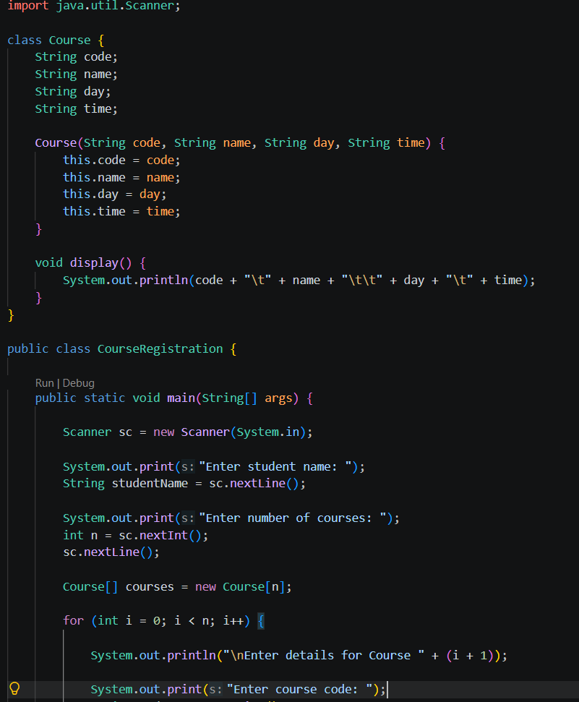
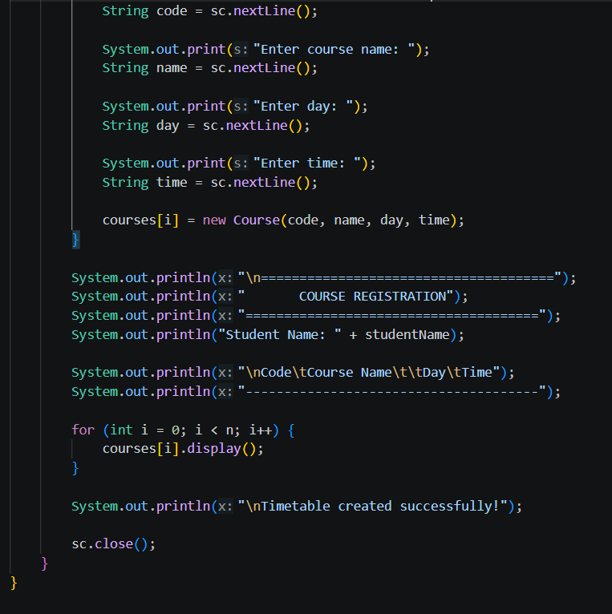
Java Code: Course Registration

Slide 12
THANK YOU!
Course Registration & Timetable Builder

